Slide 1

Principles
About
As a tool
for
team collaboration
with
Confluence
robert.reiner@smartics.de
anton.kronseder@smartics.de

Slide 2
What is a principle?
value
desirable quality (by a person)
principle
rule leading to values
practice
makes principles actionable

Slide 3
My first Wiki Experience
Strictly personal!

Slide 4
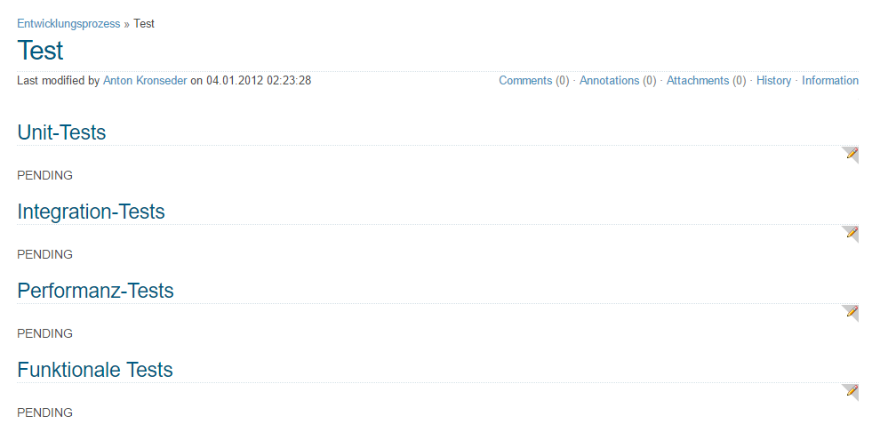
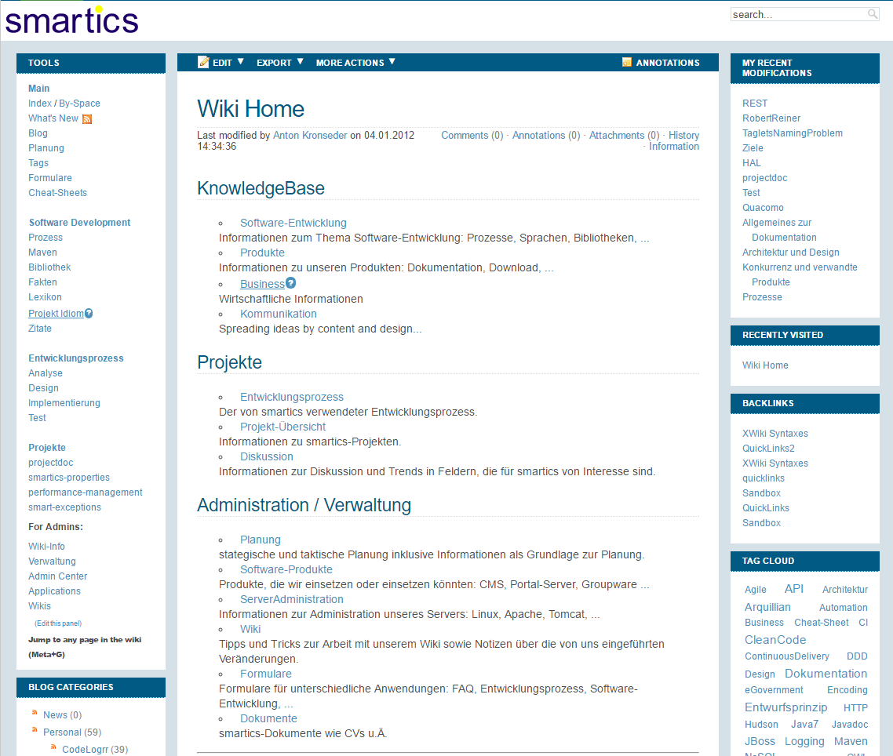
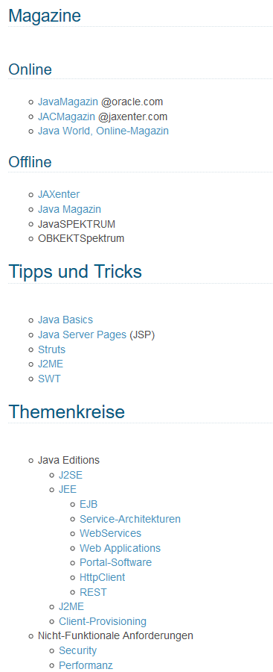
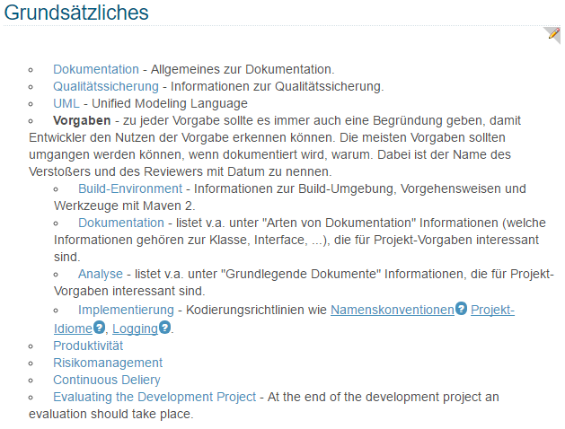
My first Wiki Experience
In the year 2012 ...

Slide 5
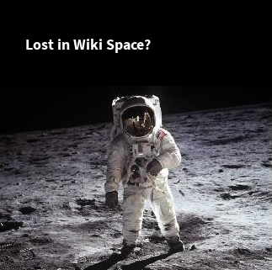
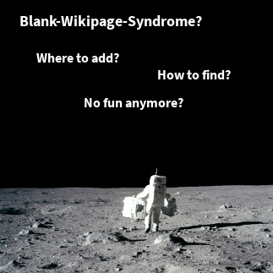

Slide 6
Organizing Information
Who else has this problem?

Slide 7

Organizing Information
Software Development
Documentation | - | Software Development
Word | - | Statement
Sentence | - | Method
Paragraph | - | Class
Section | - | Assembly
Chapter | - | Component
Book | - | Application
Documentation | - | Solution
Library | - | Society
Abstraction Layers for Software Development as proposed by Ralf Westphal
Source: http://ralfw.de

Slide 8
Principles and Practices
For Documentation
- based on Software Development

Slide 9
Documentation Principles
Open/Closed Principle
Self Documentation Principle
Principle of Least Astonishment
Direct Communication Principle
Living Documentation Principle
Separation of Concerns
Teamwork Principle
Don't Repeat Yourself (DRY)
Single Responsibility Principle
Scaling Principle
Principle of Iteration
Long-term Relevance Principle
You Ain't Gonna Need It (YAGNI)
Stable Dependencies Principle
Keep it Simple, Stupid (KISS)

Slide 10
Documentation Practices
Single Point of Access
Separate Release Cycles
Agile Documentation
Living Documentation
Tell me, I'll summarize
Categorize
Last responsible Moment
Privacy, please
Frequency of Change
Describe Content
Welded Lifespan
Single Sourcing
Employ Mapping Documents
Document State
Write to the many
Know your Mission
Favor flat Hierarchies
Dynamic Links
Keep a Journal
Maintain a Glossary
Focus on Content
Standard Layout
Employ a Style Guide
No Noise
Use Templates
Physical Location
Employ Delegate Documents
Provide multiple Views

Slide 11
Documentation Principles
Open/Closed Principle
Self Documentation Principle
Principle of Least Astonishment
Direct Communication Principle
Living Documentation Principle
Separation of Concerns
Teamwork Principle
Don't Repeat Yourself (DRY)
Single Responsibility Principle
Scaling Principle
Principle of Iteration
Long-term Relevance Principle
You Ain't Gonna Need It (YAGNI)
Stable Dependencies Principle
Keep it Simple, Stupid (KISS)

Slide 12
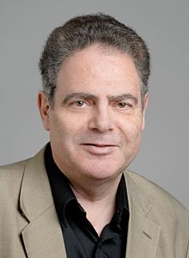
Documentation Principles
Open/Closed Principle
software entities (classes, modules, functions, etc.) should be open for extension,
but closed for modification
̶ Bertrand Meyer. 1988
Source: https://de.wikipedia.org/wiki/Bertrand_Meyer

Slide 13
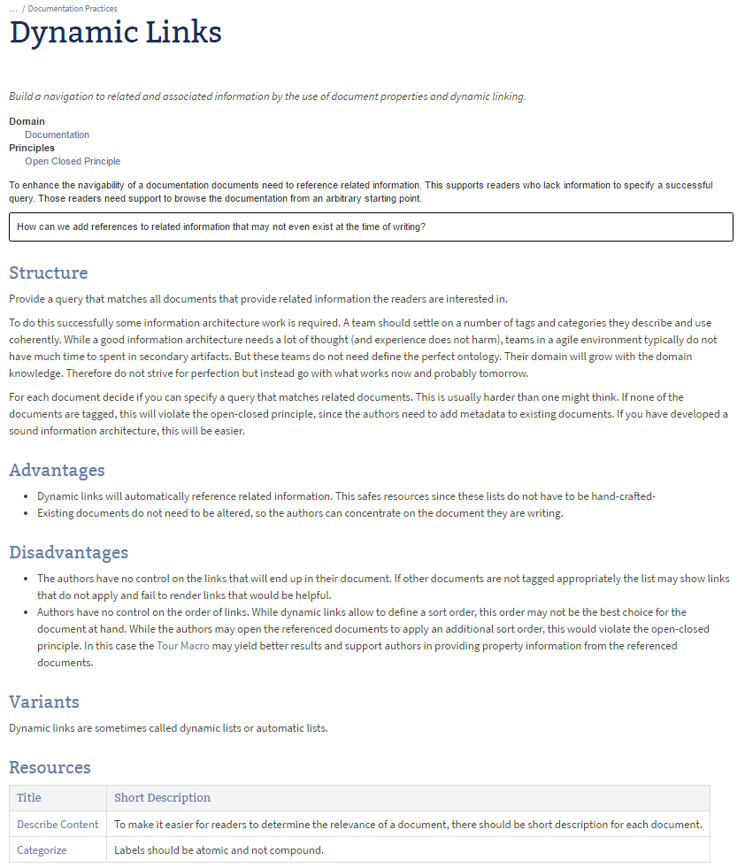
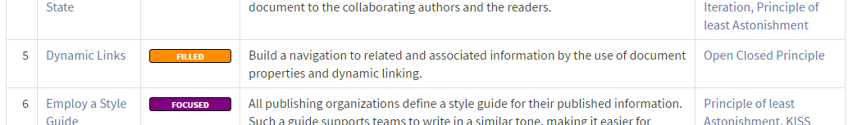
Documentation Practices
Dynamic Links

Slide 14
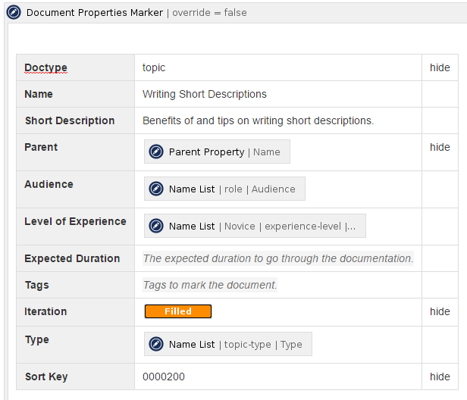
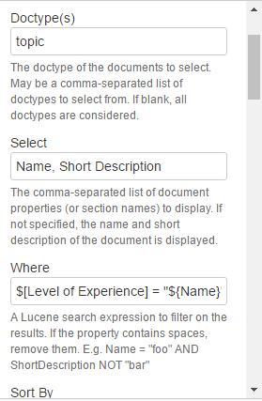
Example: Dynamic Links
Document Properties Marker Macro
Display Table Macro
Dynamic Links
DEMO
Macros from the
projectdoc Toolbox for Confluence
https://marketplace.atlassian.com/1212629

Slide 15
Documentation Principles
Open/Closed Principle
Self Documentation Principle
Principle of Least Astonishment
Direct Communication Principle
Living Documentation Principle
Separation of Concerns
Teamwork Principle
Don't Repeat Yourself (DRY)
Single Responsibility Principle
Scaling Principle
Principle of Iteration
Long-term Relevance Principle
You Ain't Gonna Need It (YAGNI)
Stable Dependencies Principle
Keep it Simple, Stupid (KISS)

Slide 16
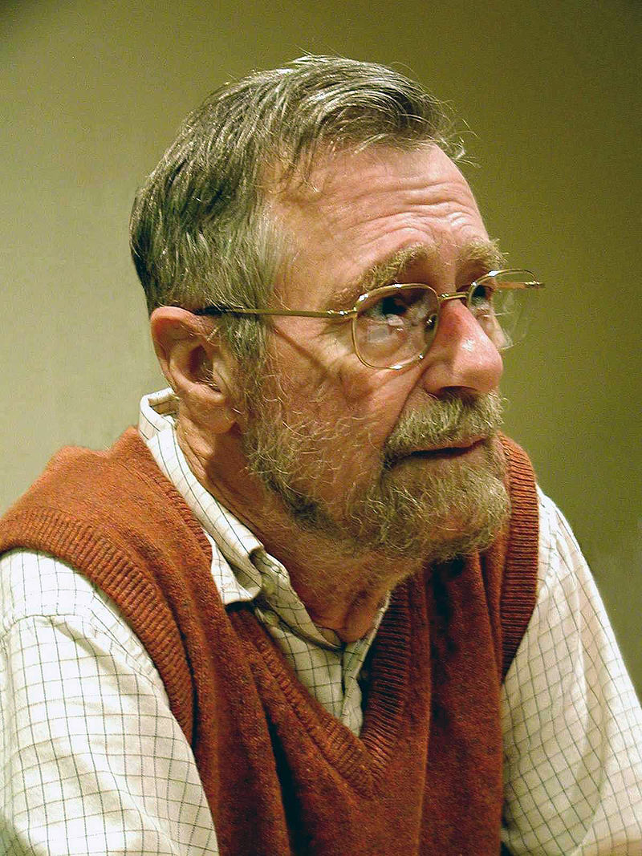
Documentation Principles
Separation of Concerns
On the role of scientific thought:
"the separation of concerns", [... is a] technique for effective ordering of one's thoughts, [...]: it does not mean ignoring the other aspects, it is just doing justice to the fact that from this aspect's point of view, the other is irrelevant."
̶ Edsger W. Dijkstra. 1974
Source: https://de.wikipedia.org/wiki/Edsger_W._Dijkstra

Slide 17
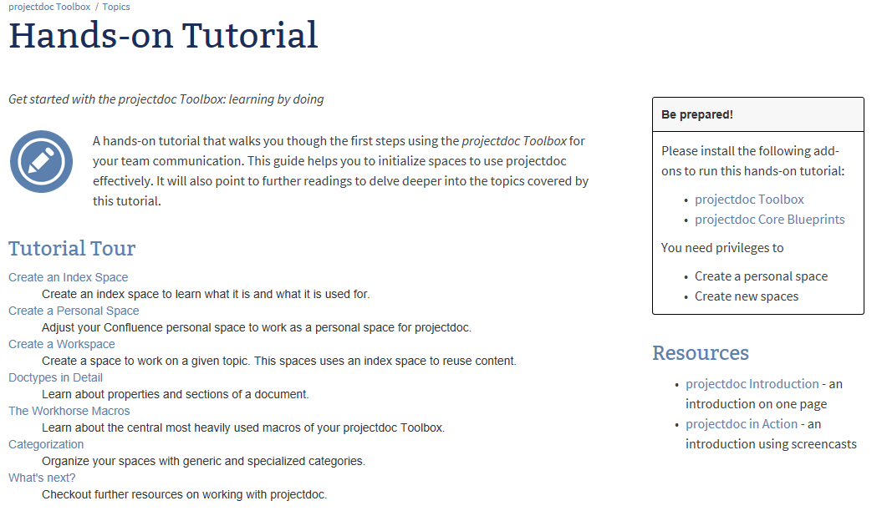
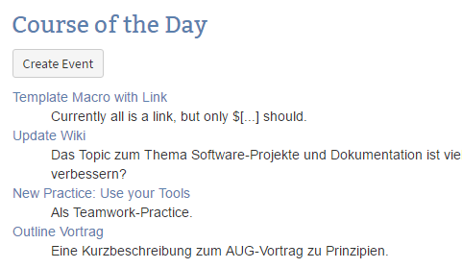
Documentation Practices
Frequency of Change
Document vs. Record

Slide 18
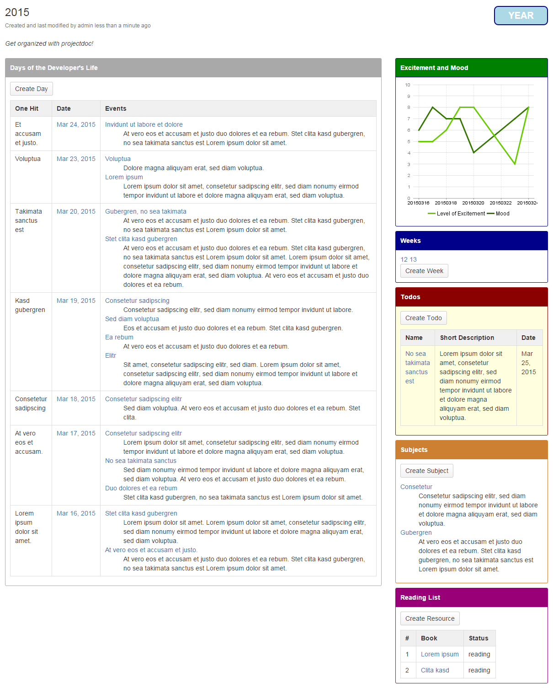
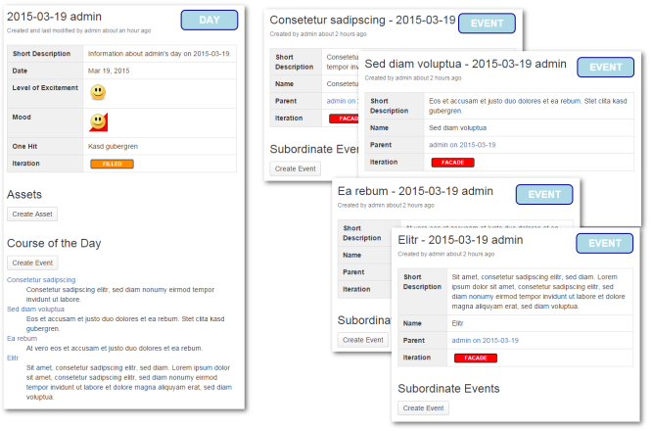
Documentation Practices
Keep a Personal Journal

Slide 19
Documentation Practices
Keep a Personal Journal
DEMO

Slide 20
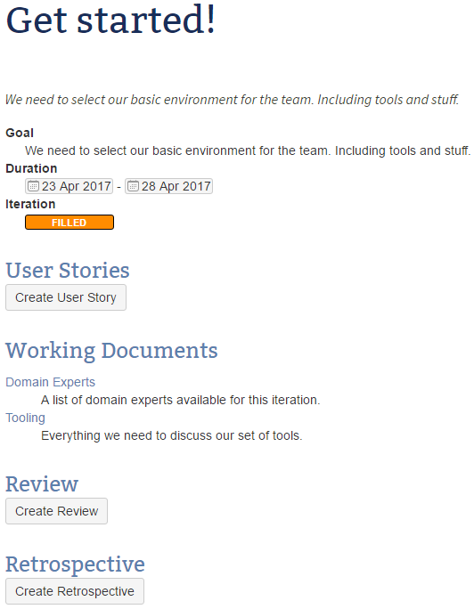
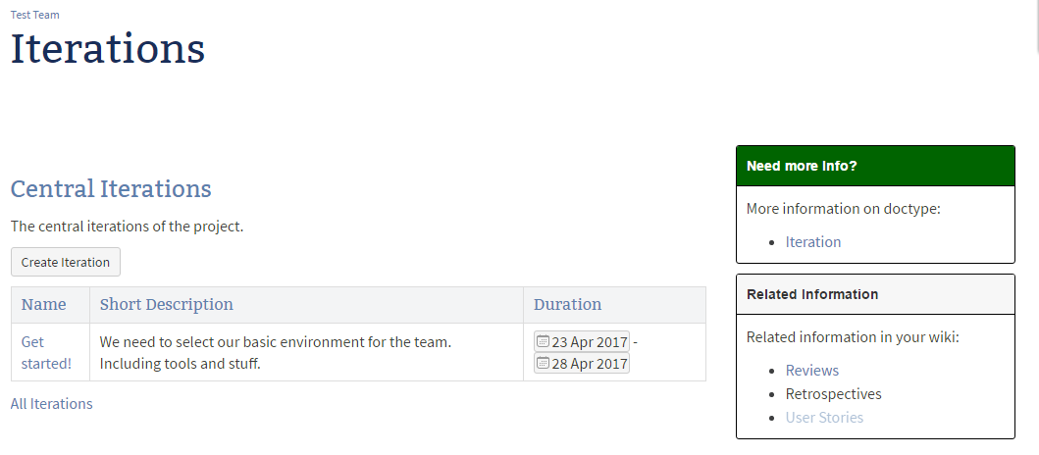
Documentation Practices
Keep a Team Journal

Slide 21
Documentation Principles
Open/Closed Principle
Self Documentation Principle
Principle of Least Astonishment
Direct Communication Principle
Living Documentation Principle
Separation of Concerns
Teamwork Principle
Don't Repeat Yourself (DRY)
Single Responsibility Principle
Scaling Principle
Principle of Iteration
Long-term Relevance Principle
You Ain't Gonna Need It (YAGNI)
Stable Dependencies Principle
Keep it Simple, Stupid (KISS)

Slide 22

Documentation Principles
Principle of Least Astonishment
"It is simply that the program should always respond to the user in the way that astonishes him least."
̶ Geoffrey James, The Tao of Programming. 1986
Source : https://www.goodreads.com/author/show/155036.Geoffrey_James

Slide 23
Documentation Practices
No Noise
Decoy text
Section titles
Section introduction texts
Tedious representation
Table instead of definition list
One element lists as lists
Short description in properties table
Skeleton Page
Sections without body
Example content
Dead Links

Slide 24
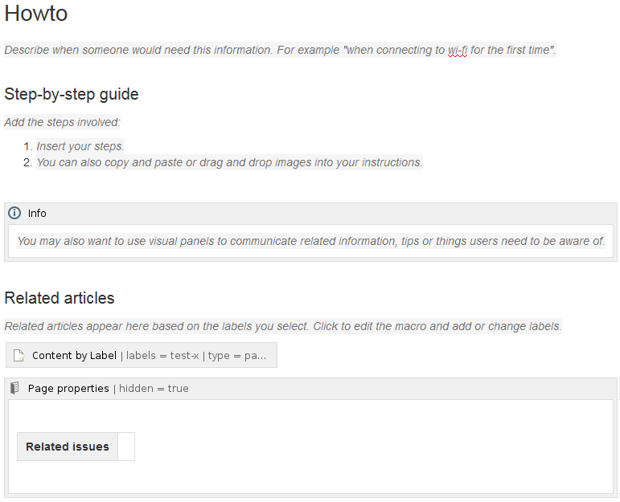
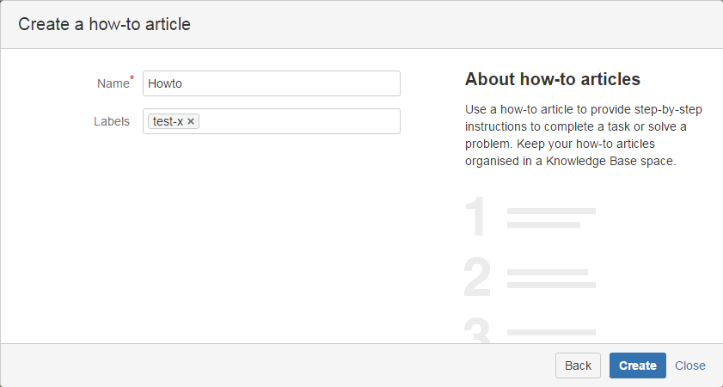
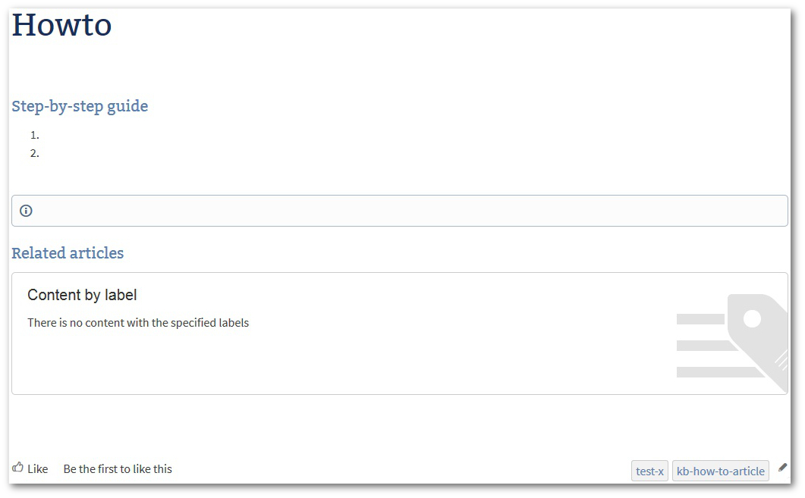
Documentation Practices
No Noise
Noise actually!
DEMO

Slide 25
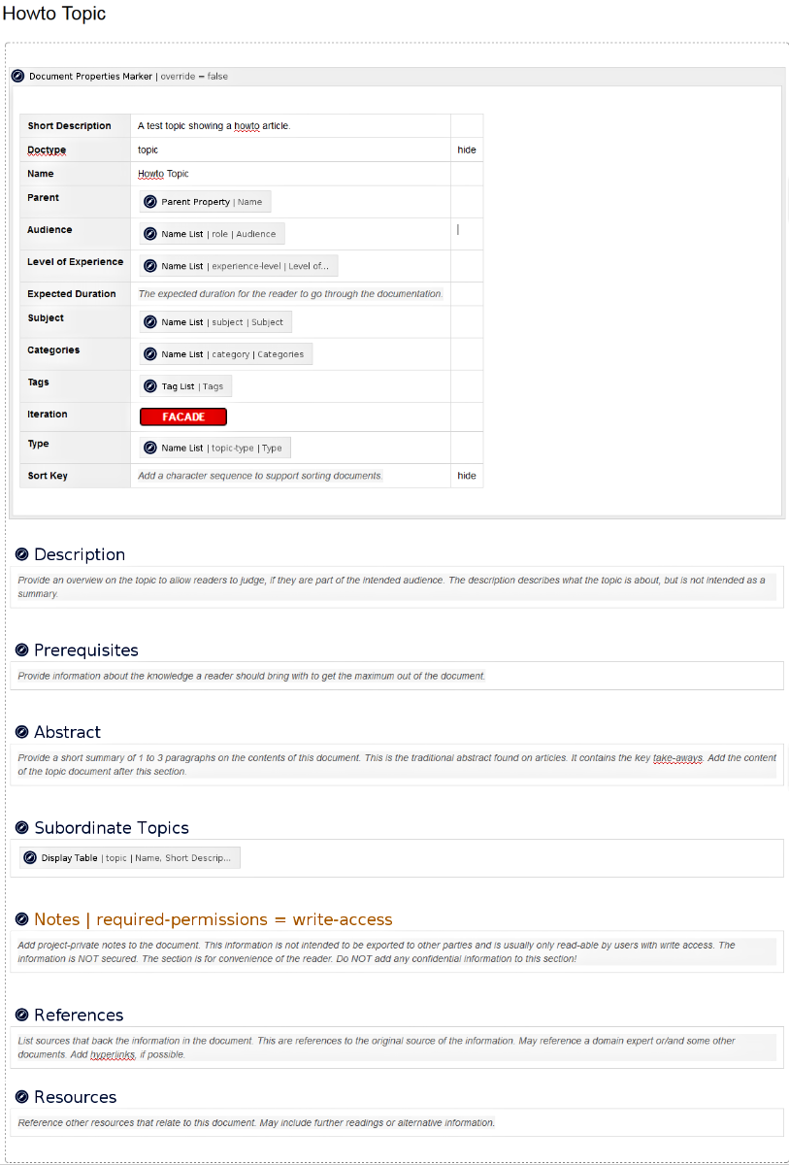
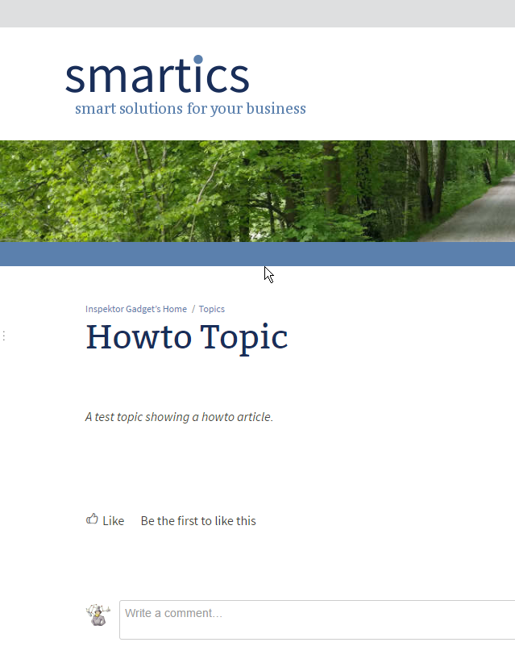
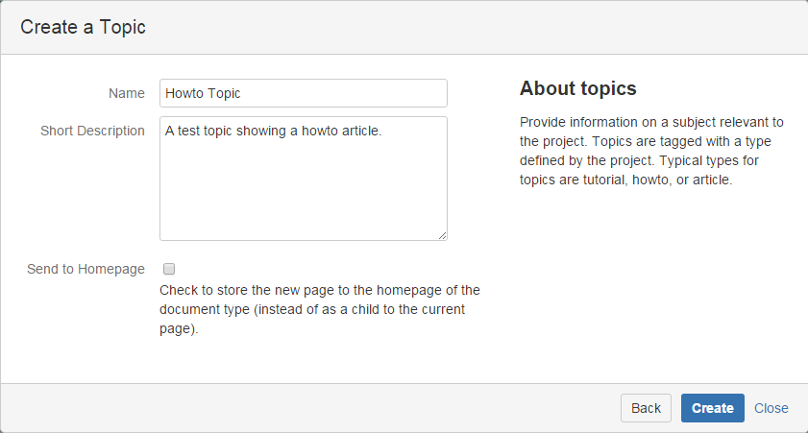
Documentation Practices
No Noise

Slide 26
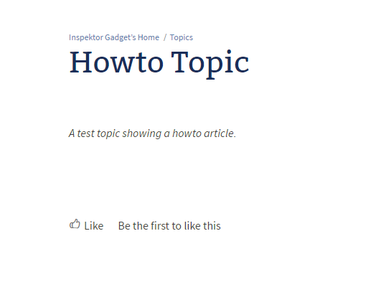
Documentation Practices
No Noise

Slide 27
Macros and Add-ons
Confluence
Page Properties Macro
Page Properties Report Macro
Content By Label Macro
Children Display Macro
Metadata Plugin
Project Documentation Macros
$ Metadata for Confluence
$ projectdoc Toolbox for Confluence

Slide 28
Lessons learned
From my first Wiki Experience

Slide 29
Lessons Learned
First Wiki - Retrospective
Make it worth your while
Know what is important
What is your domain?
What is relevant for you on the long run?
Consider maintenance cost
Create a (basic) organization scheme
Share your intention
Define audience & co-authors from the start
Describe your content (briefly)
Have access to an appropriate toolset

Slide 30
Summary
What to take away?

Slide 31
Summary
Recap
Value - Principle - Practice
Example of Pitfalls: our first Wiki
Principles - from Software Development!
Open / Closed Principle
Practice: Dynamic Links
Separation of Concerns
Practice: Document vs. Record
Practice: Keep a Journal
Principle of Least Astonishment
Practice: No Noise
Lessons learned

Slide 32






Summary
For Software Developers
Apply
Software Development
Principles
for
team collaboration
in your
Confluence
smartics.de
info@smartics.de
@smartics

Slide 33
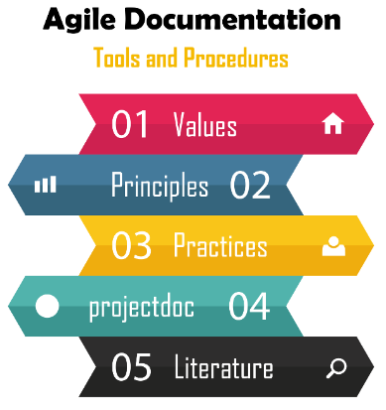
Summary
Apply
Software Development
Principles
for
team collaboration
in your
Confluence
For Everyone!!!!!!
https://www.smartics.de/go/agiledoc
smartics.de
info@smartics.de
@smartics

